Slide 1
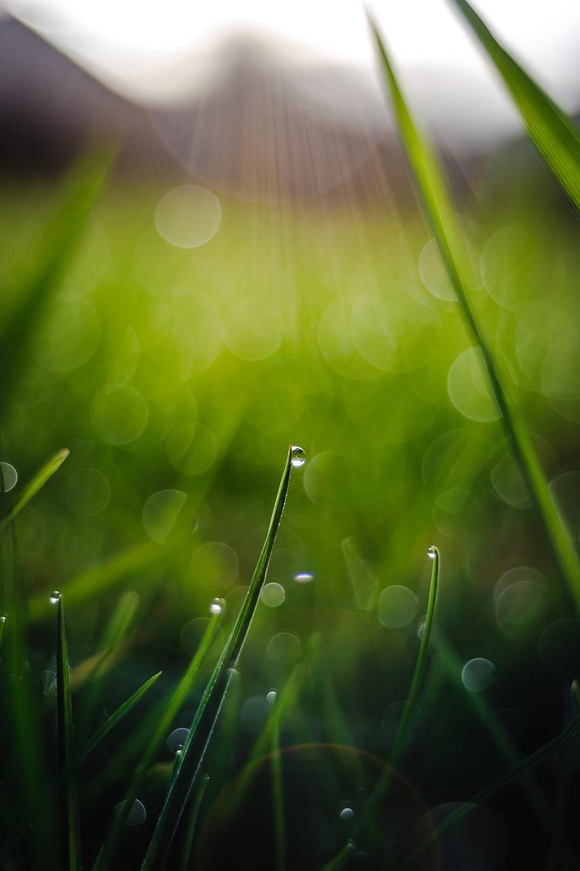


We would like to introduce and offer you the new
Living Values Education Values Bookmarks.
There are 24 different bookmark-sized cards, two on each of twelve values, that can be used in a multitude of ways: as focus points in workshops, inspiration cards, daily thoughts for reflection, displays or reminders at home or school, gifts - or bookmarks!
They are available for download and printing at www.livingvalues.net/resources-bookmarks
gh
The Association for Living Values Education International offers these in support of World Values Day on 15th October 2020.

Slide 2
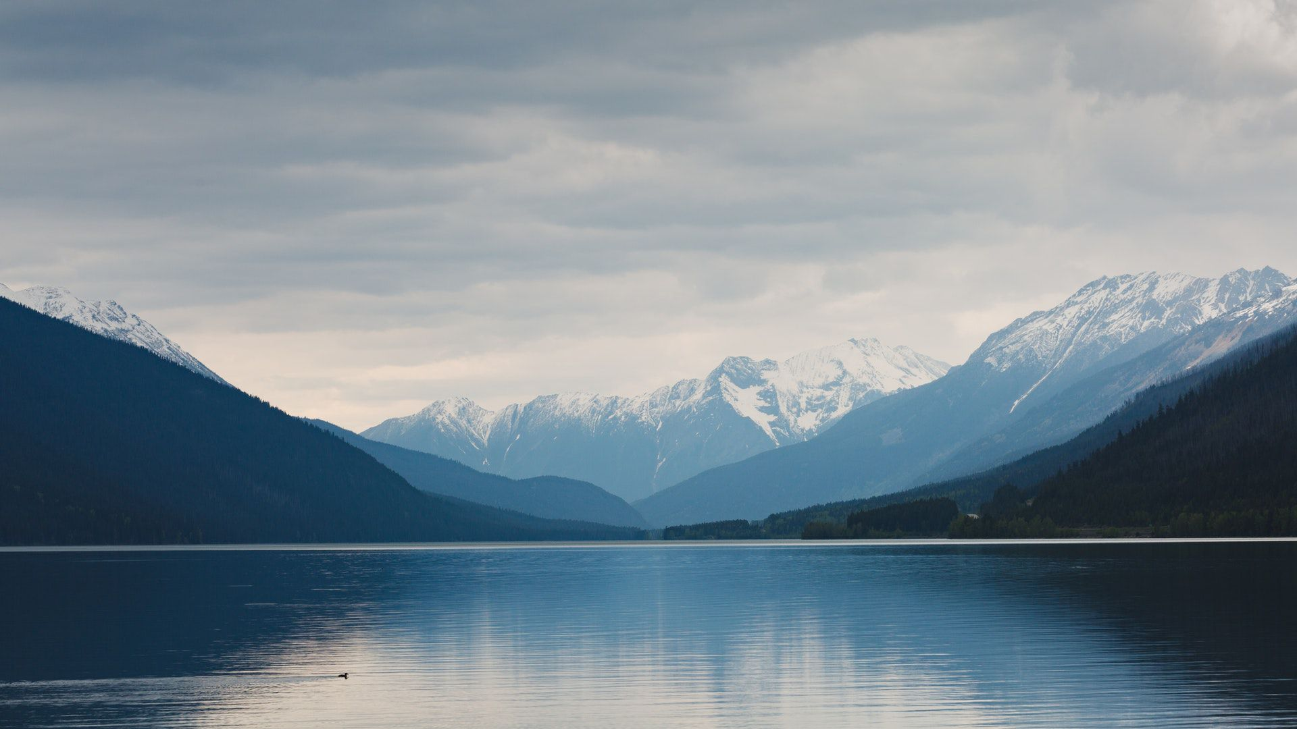
PEACE

Slide 3

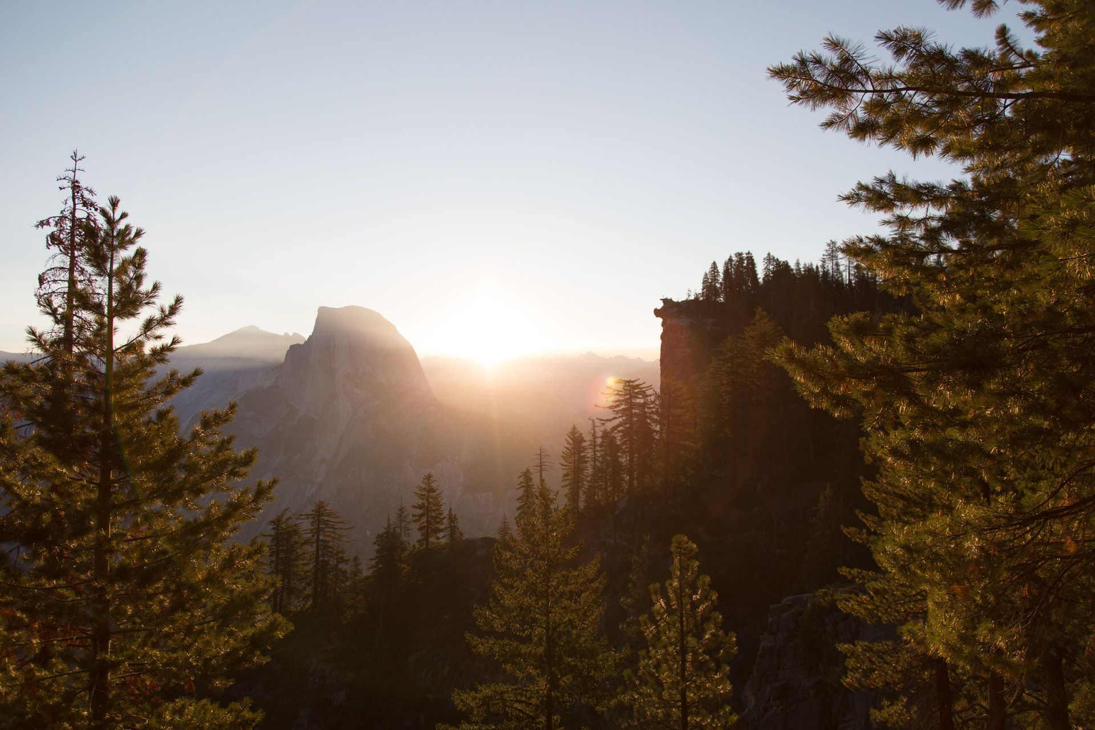

Peace begins with each one of us. If everyone in the world were peaceful, this would be a peaceful world.
Peace consists of pure thoughts, pure feelings, and pure wishes.
Pause for Thought
What does “peace” mean to you?
What can we do to make this a peaceful world?
Pause for Thought
Think of someone who is an inspiring example of peace. What makes them so special?
http://www.livingvalues.net
http://www.livingvalues.net

Slide 4

RESPECT

Slide 5


Respect is knowing I am unique and valuable. Respect is knowing others are valuable, too.
Respect is listening to others.
Pause for Thought
What does “respect” mean to you?
How could you develop the value of respect in your life?
Pause for Thought
What does “respect” mean to you?
How would you like people to treat each other?
http://www.livingvalues.net
http://www.livingvalues.net

Slide 6
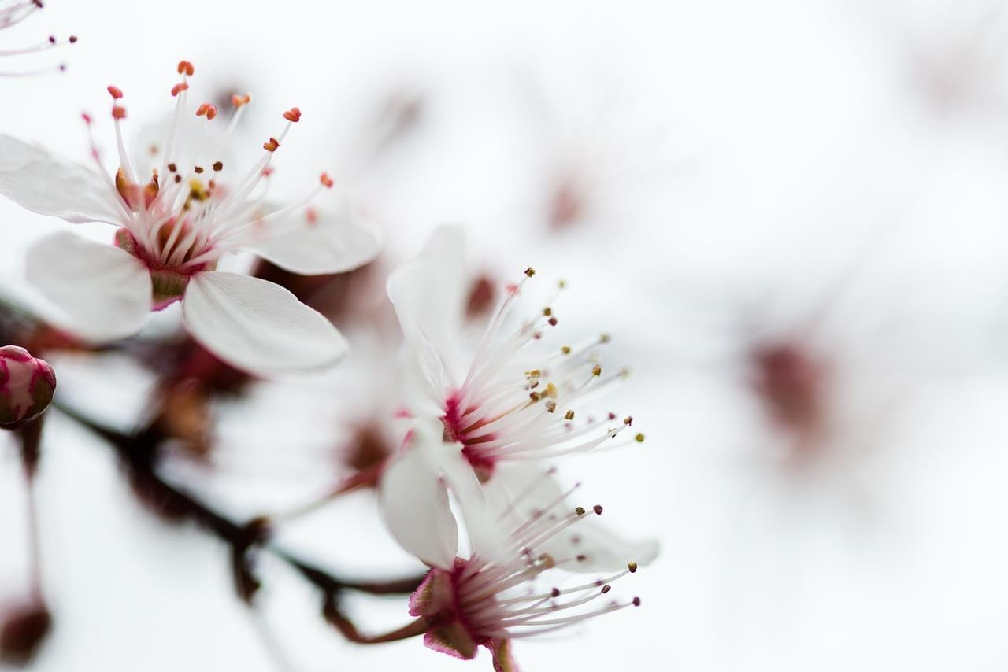
LOVE

Slide 7

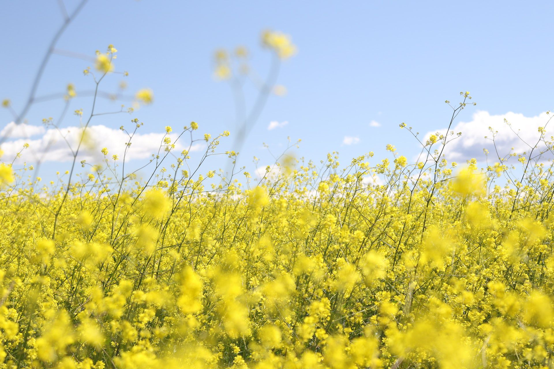

Love is the catalyst for change, development, and achievement.
Love is caring, love is sharing.
Pause for Thought
Why is love important?
In what ways do you demonstrate love in your life?
Pause for Thought
What does “love” mean to you?
How can we build a more loving world?
http://www.livingvalues.net
http://www.livingvalues.net

Slide 8
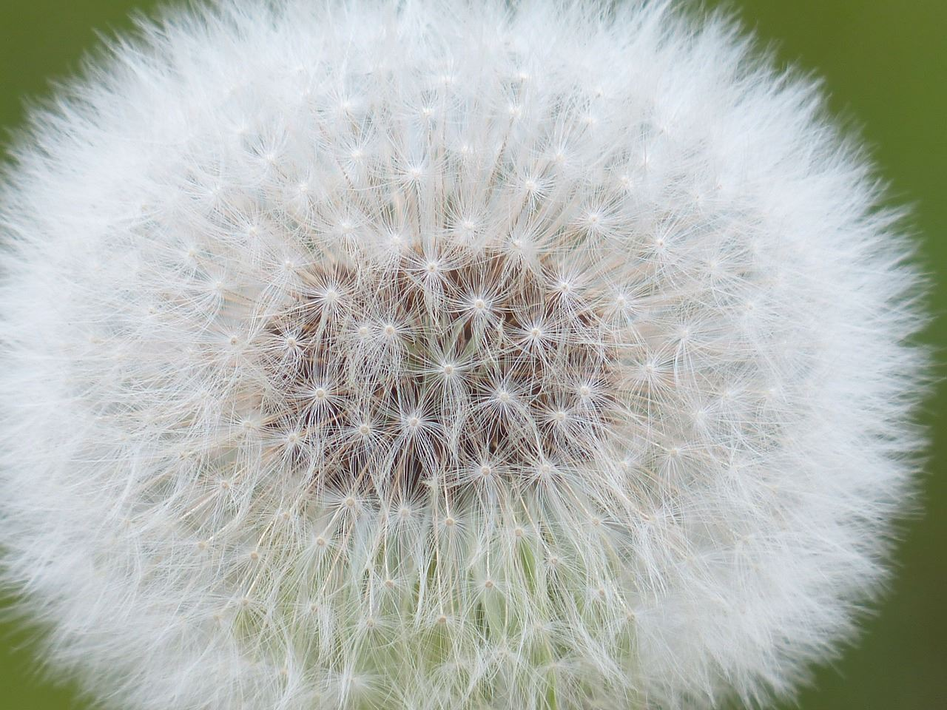
TOLERANCE

Slide 9

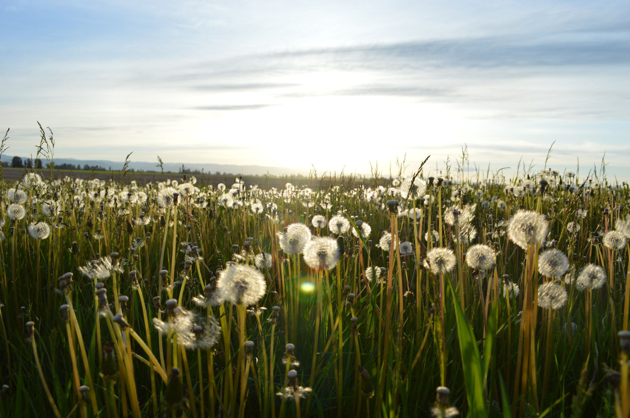
Tolerance is mutual respect through mutual understanding.
Tolerance is respecting and appreciating the culture of others.
Pause for Thought
What does “tolerance” mean to you?
How do you demonstrate tolerance in life?
Pause for Thought
What does “tolerance” mean to you?
How can we develop greater tolerance power?
http://www.livingvalues.net
http://www.livingvalues.net

Slide 10
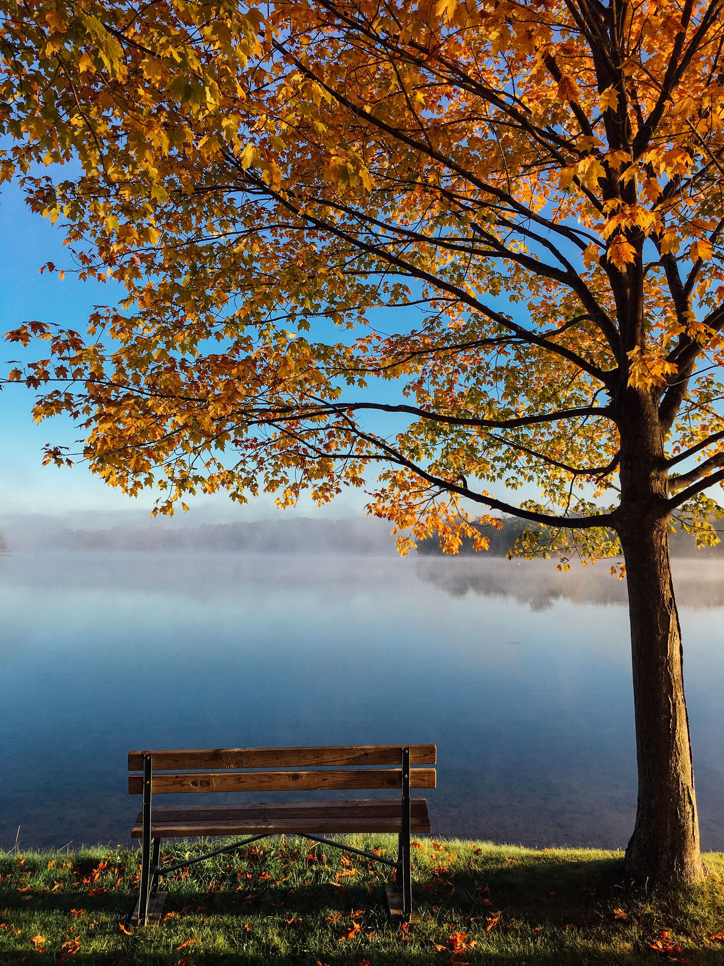
HONESTY

Slide 11
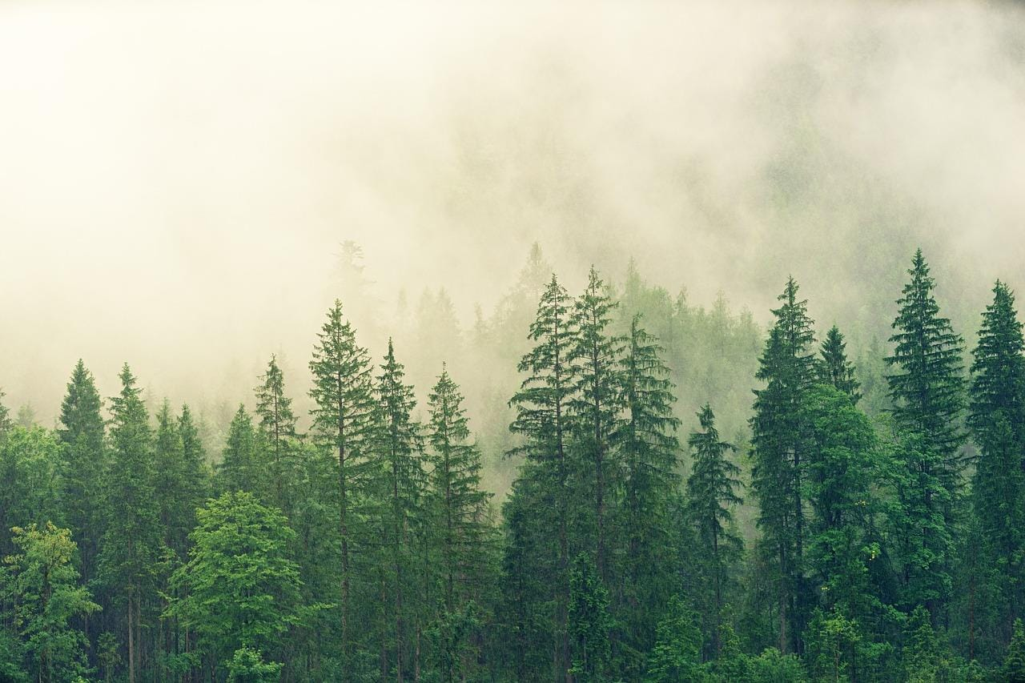

Honest thoughts, words, and actions create harmony.
Honesty is telling the truth. When I am honest, I feel clear inside.
Pause for Thought
What does “honesty” mean to you?
In what ways are you honest with yourself and others?
Pause for Thought
What does “honesty” mean to you?
What could you do to develop greater honesty in your life?
http://www.livingvalues.net
http://www.livingvalues.net

Slide 12
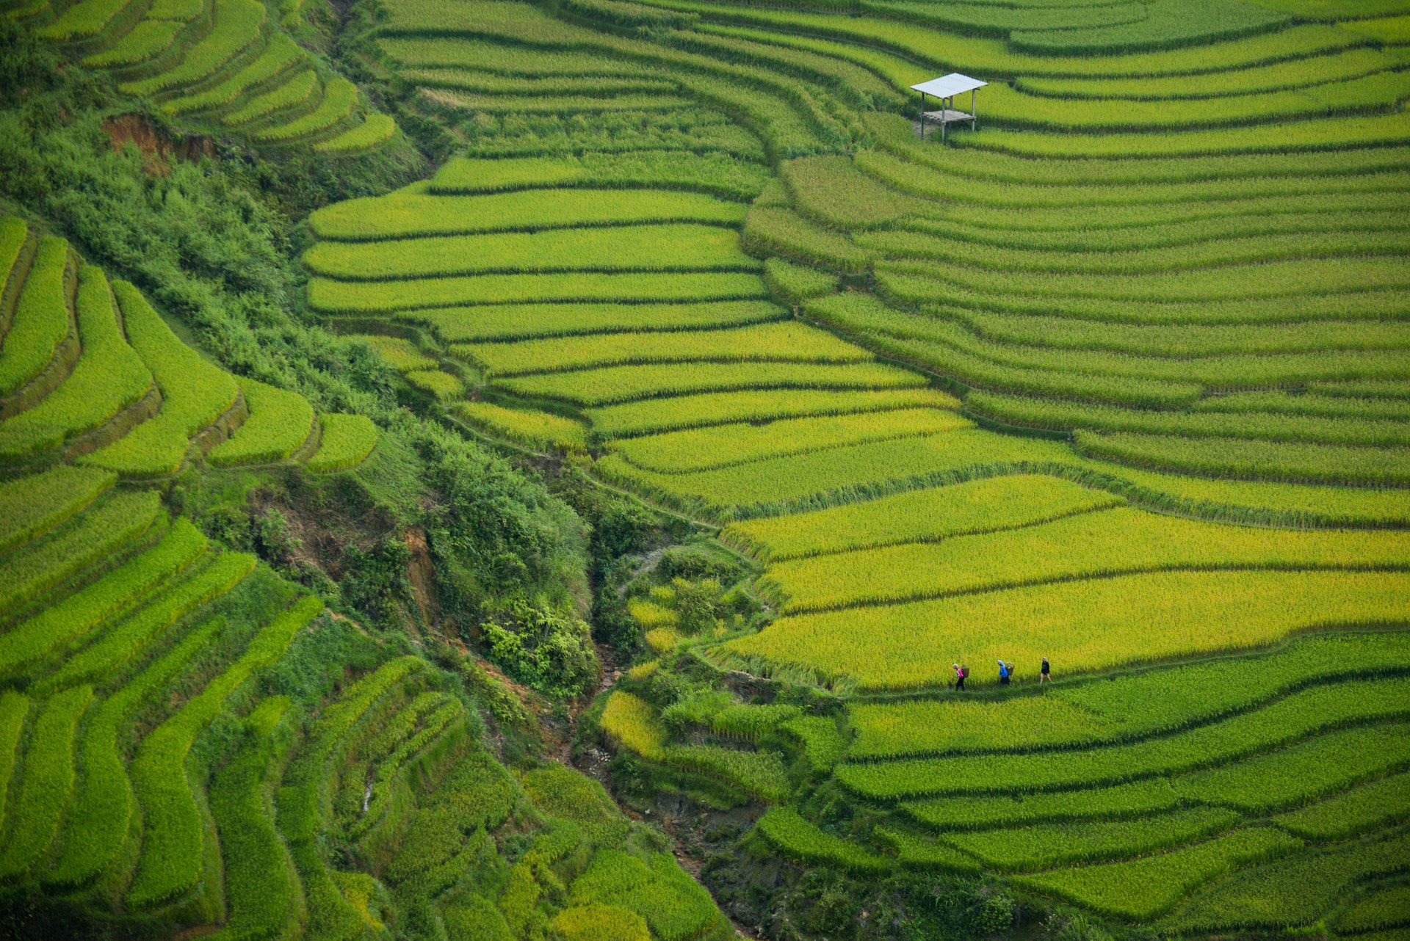
HUMILITY

Slide 13
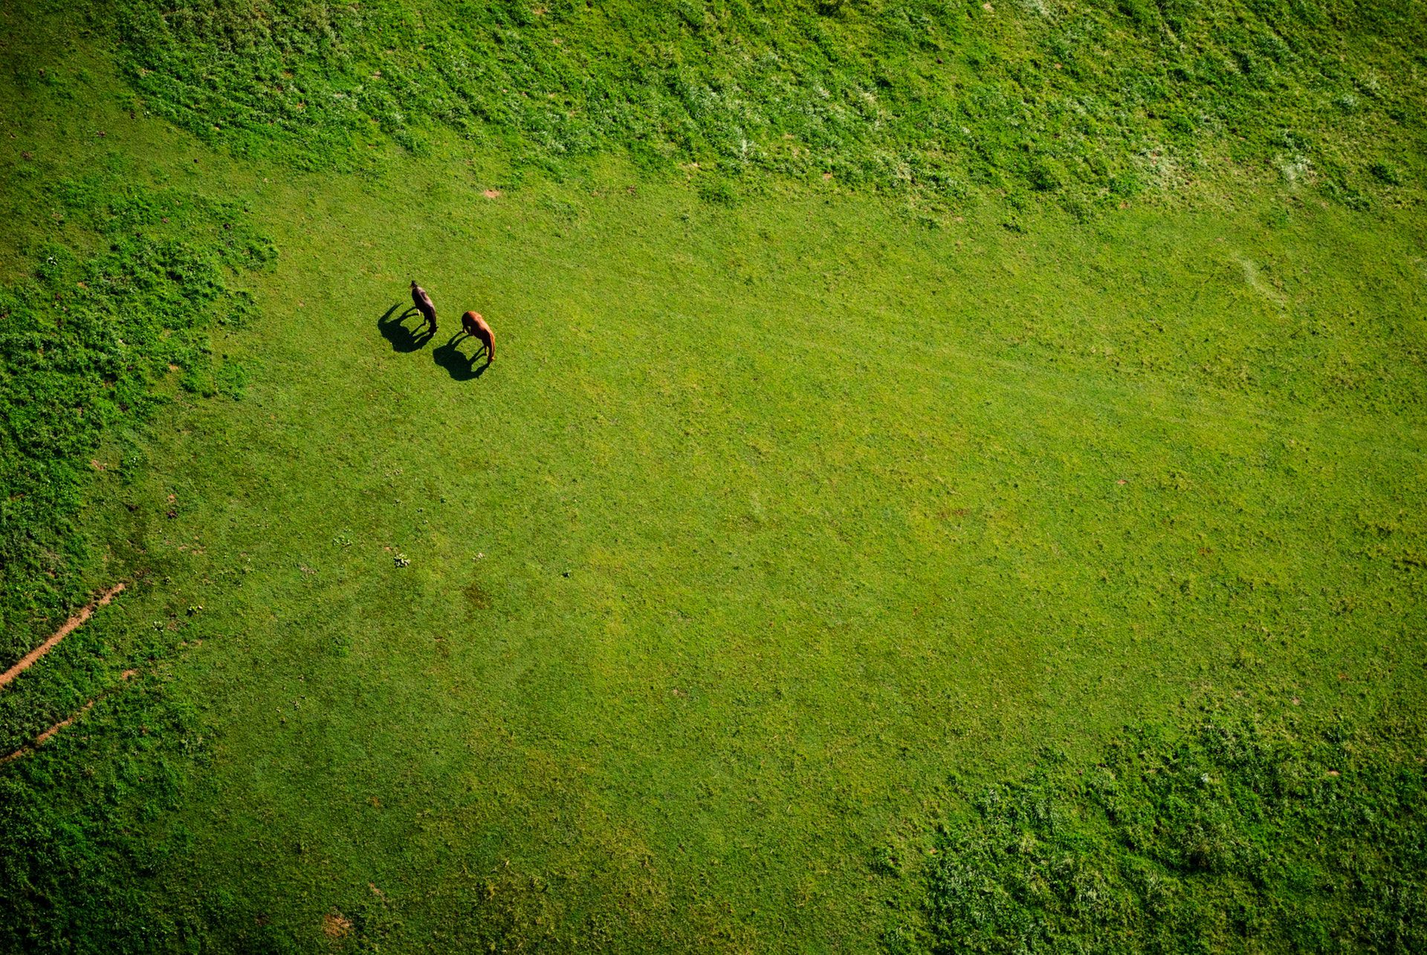

Humility creates an open mind and recognition of the strengths of the self and others..
Humility allows one to be great in the hearts of others.
Pause for Thought
What does “humility” mean to you?
How could you achieve greater humility in your life?
Pause for Thought
What does “humility” mean to you?
Why is humility important to you?
http://www.livingvalues.net
http://www.livingvalues.net

Slide 14
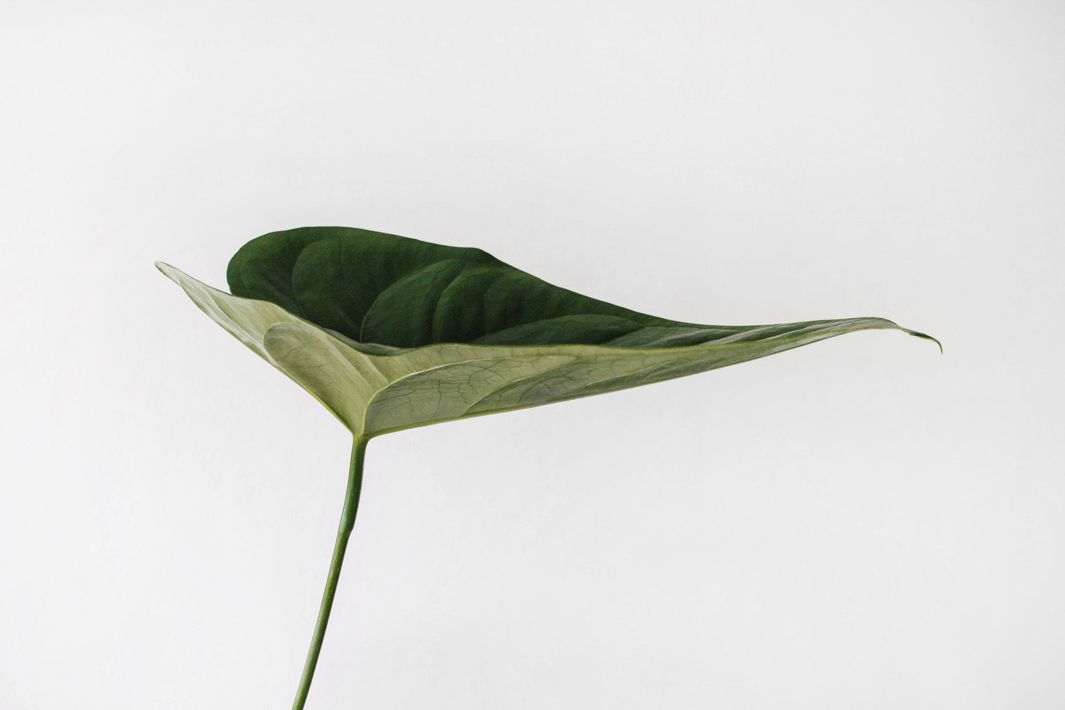
RESPONSIBILITY

Slide 15


Responsibility is using our resources to generate positive change.
Responsibility is helping to make a better world.
Pause for Thought
What does “responsibility” mean to you?
What contribution do you feel proud of?
Pause for Thought
What does “responsibility” mean to you?
What contribution do you feel proud of?
http://www.livingvalues.net
http://www.livingvalues.net

Slide 16
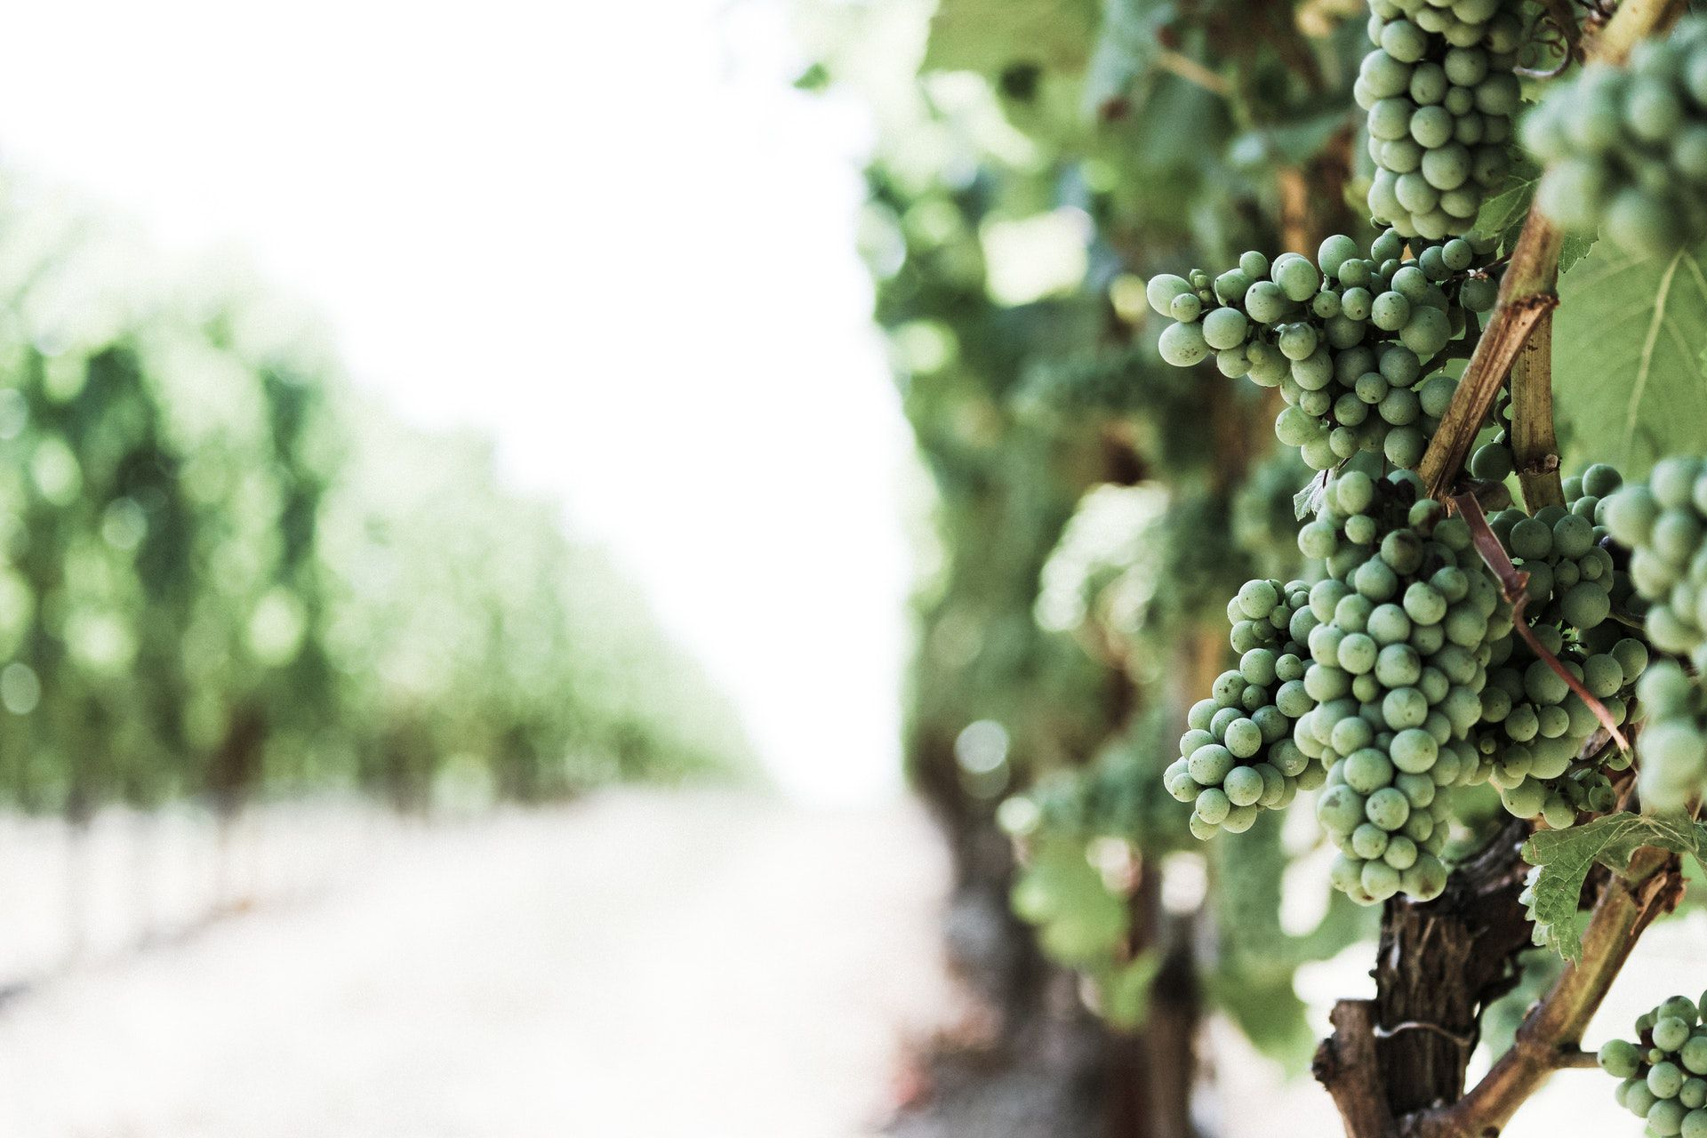
COOPERATION

Slide 17
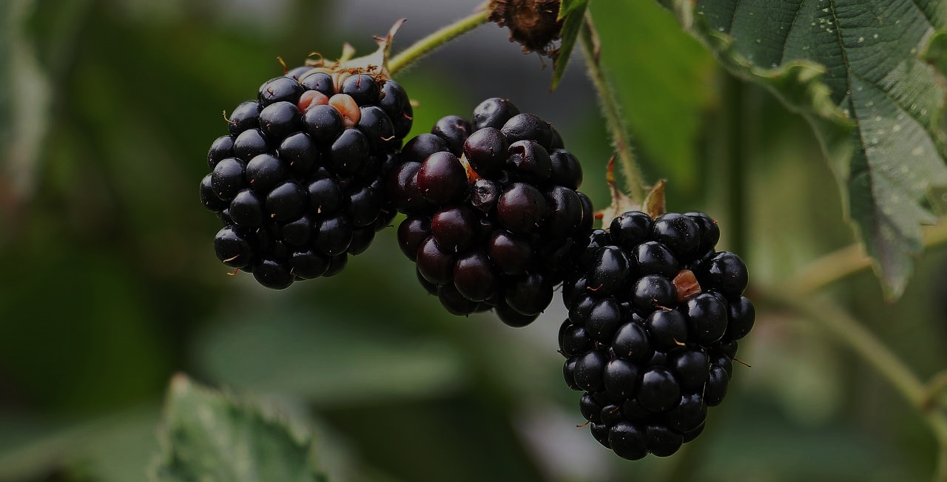
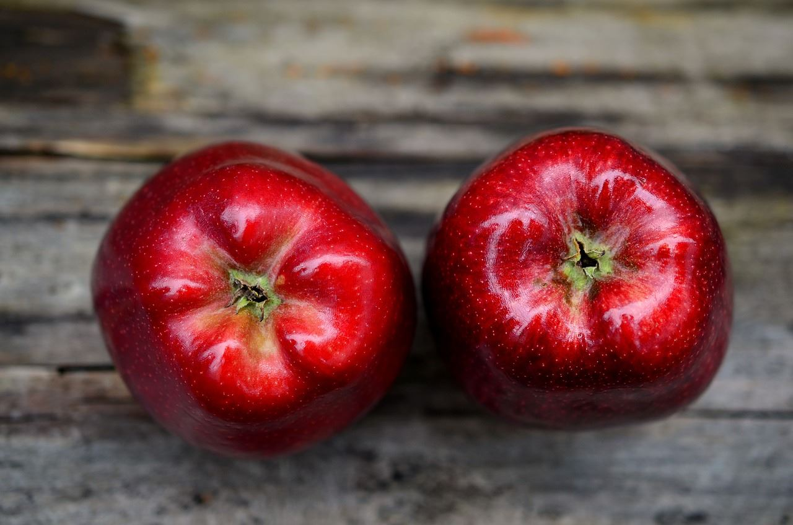
Cooperation is governed by the principle of mutual respect.
Cooperation exists when people work together toward
a common goal.
Pause for Thought
What does “cooperation” mean to you?
In what way do you cooperate with others?
Pause for Thought
What does “cooperation” mean to you?
What could you do to develop the ability to cooperate?
http://www.livingvalues.net
http://www.livingvalues.net

Slide 18

HAPPINESS

Slide 19


Happiness naturally comes with pure and selfless actions.
Happiness is earned through selfless attitudes and actions.
Pause for Thought
What does “happiness” mean to you?
In what ways do you express your happiness?
Pause for Thought
What does “happiness” mean to you?
What would the world be like if everyone were happy?
http://www.livingvalues.net
http://www.livingvalues.net

Slide 20
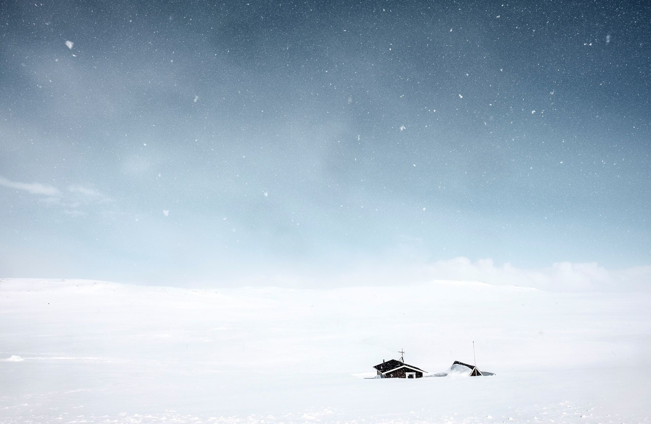
SIMPLICITY

Slide 21

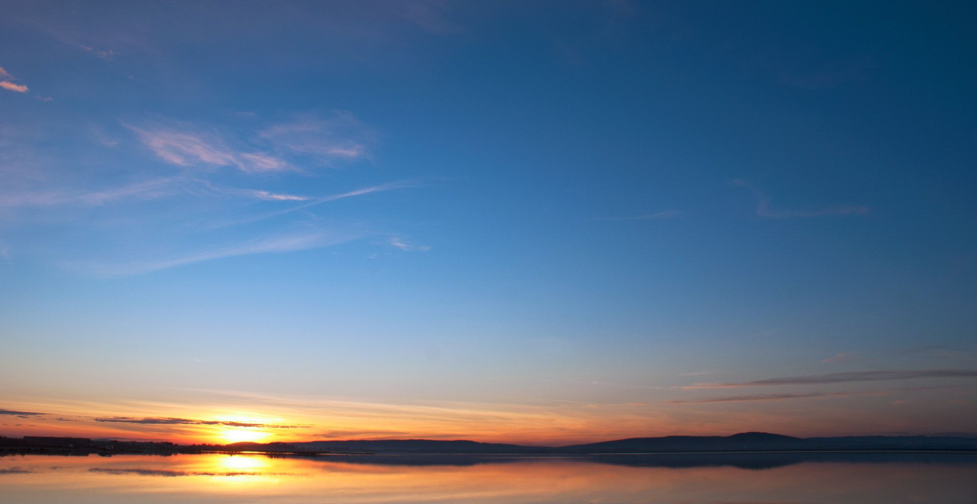
Simplicity is staying in the present and not making things complicated.
Simplicity is appreciating small things in life.
Pause for Thought
What is simplicity?
In what ways can life be simplified?
Pause for Thought
What does “simplicity” mean to you?
What simple things do you enjoy doing?
http://www.livingvalues.net
http://www.livingvalues.net

Slide 22

FREEDOM

Slide 23

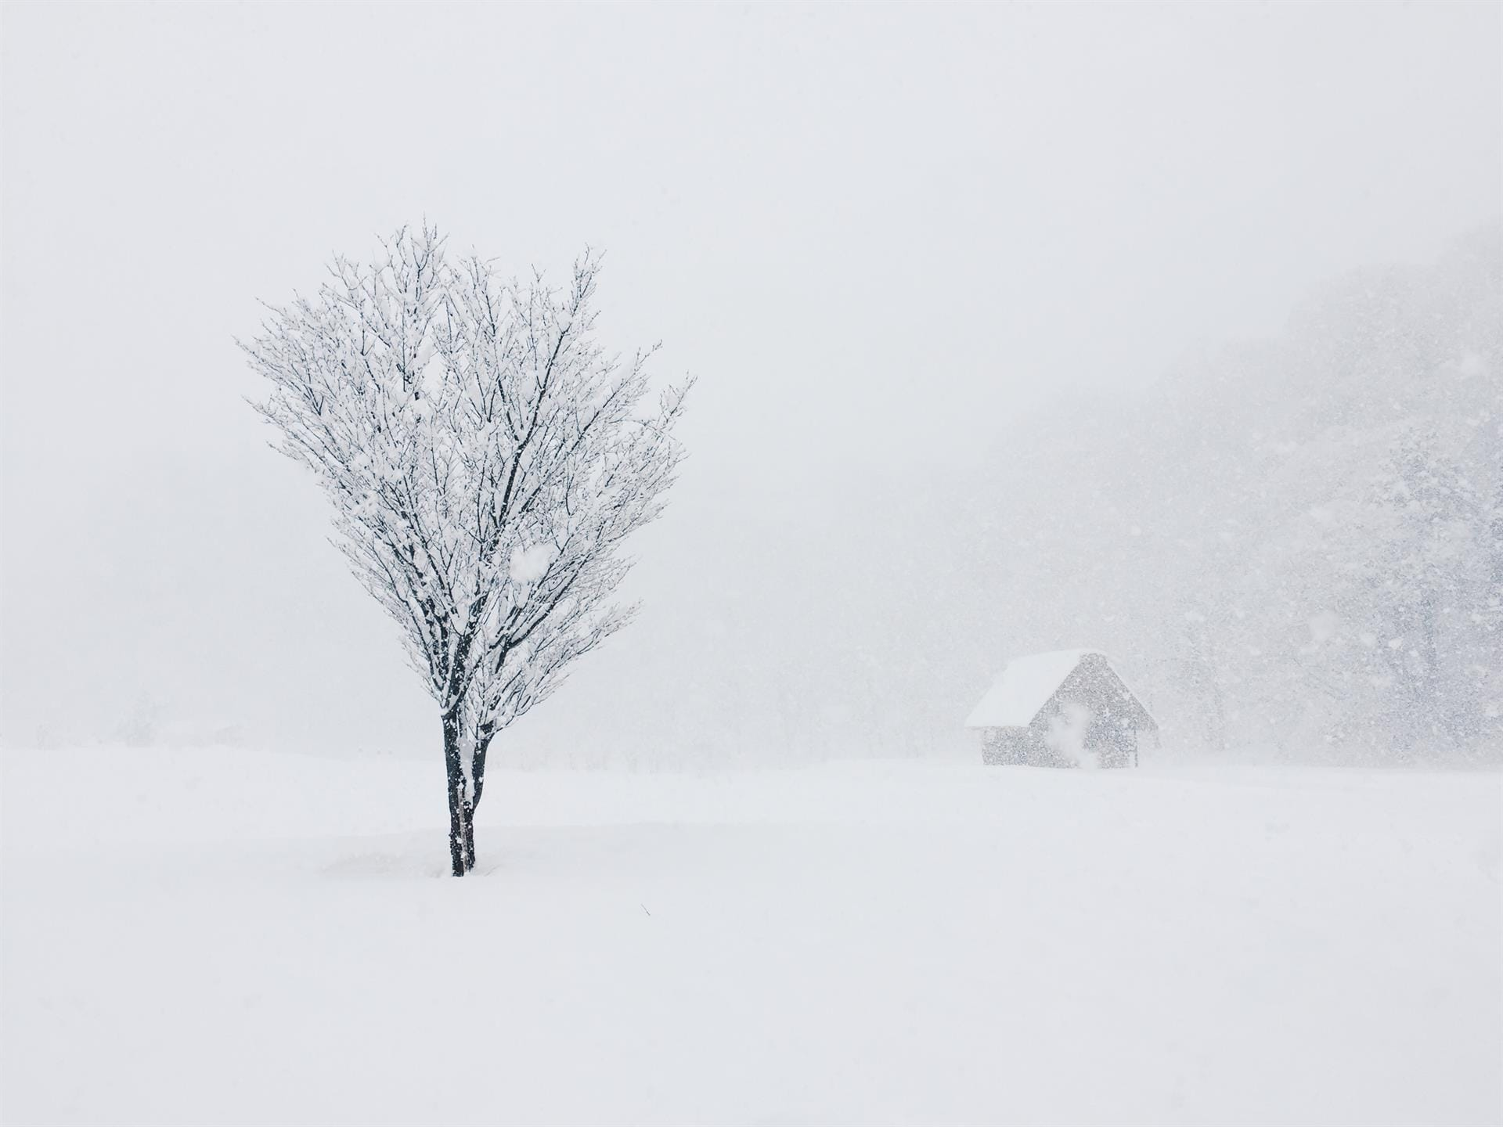
Freedom, when aligned with the human conscience is liberating, empowering and enabling.
Freedom resides within the mind and heart.
Pause for Thought
What does “freedom” mean to you?
What would the world be like if everyone has equal right?
Pause for Thought
What does “freedom” mean to you?
What would the world be like if everyone has equal right?
http://www.livingvalues.net
http://www.livingvalues.net

Slide 24
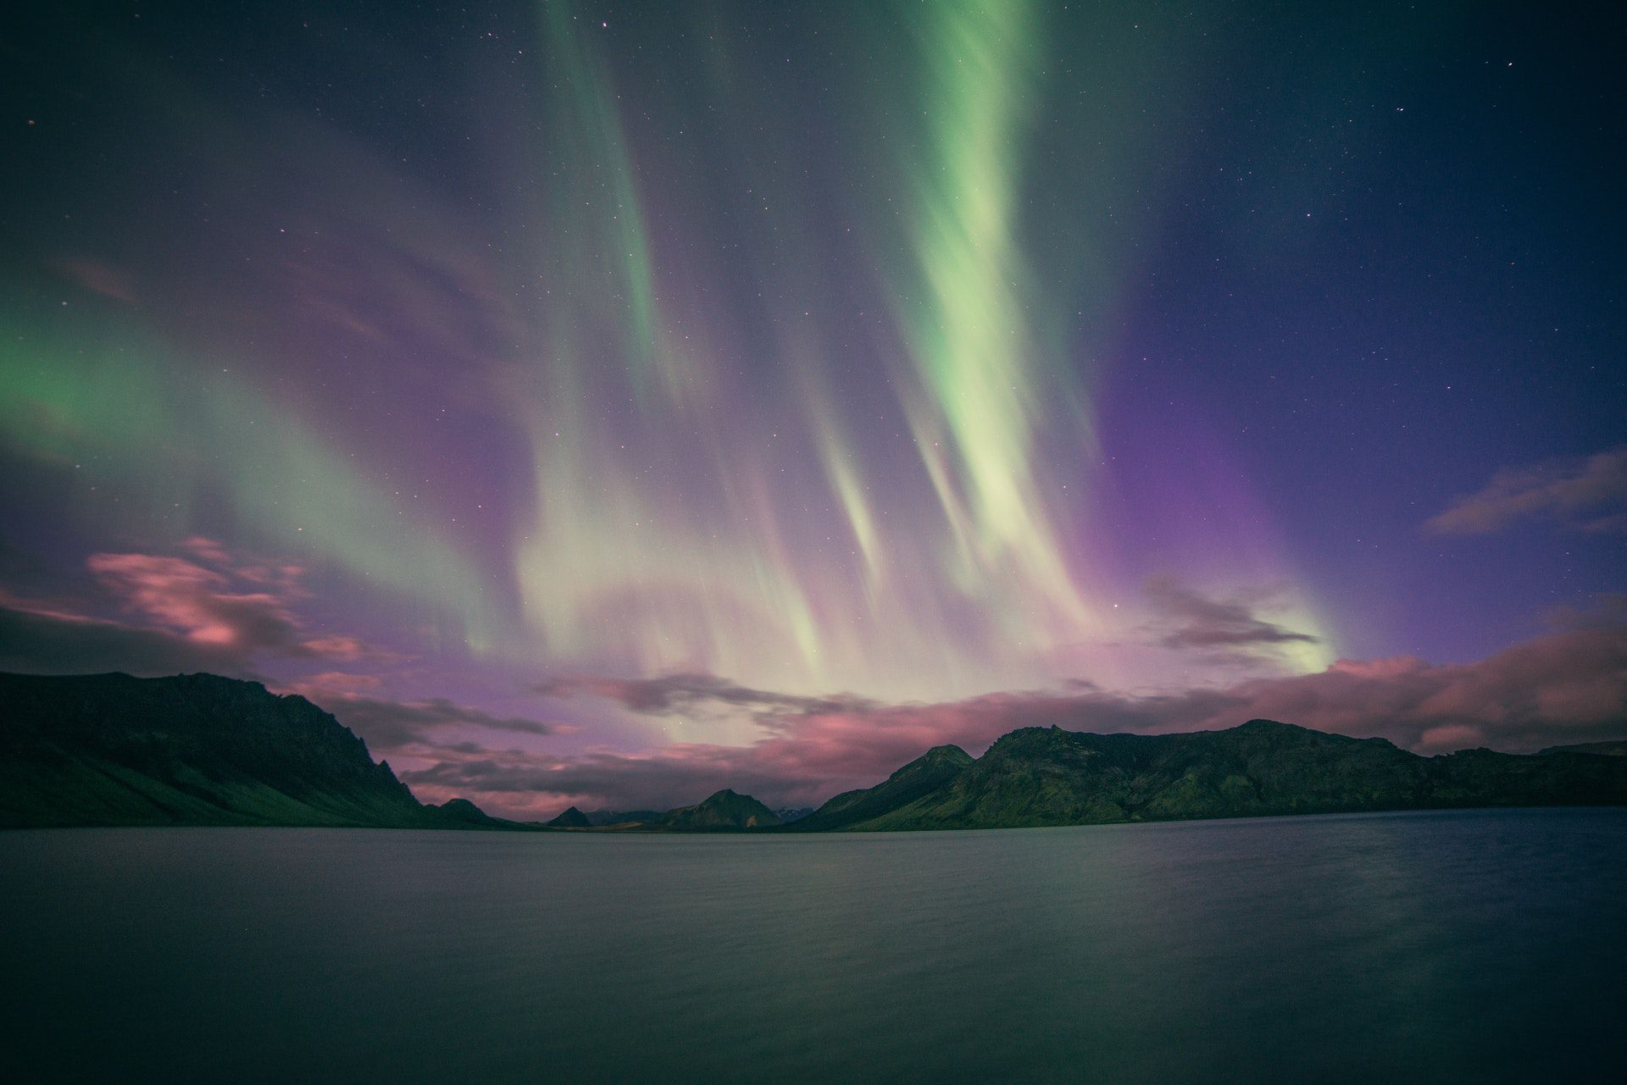
UNITY

Slide 25
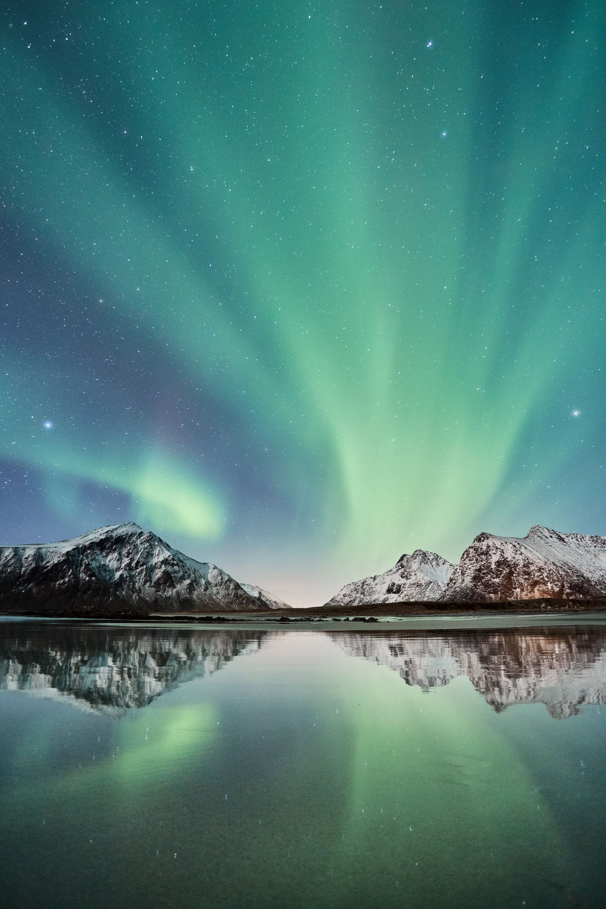
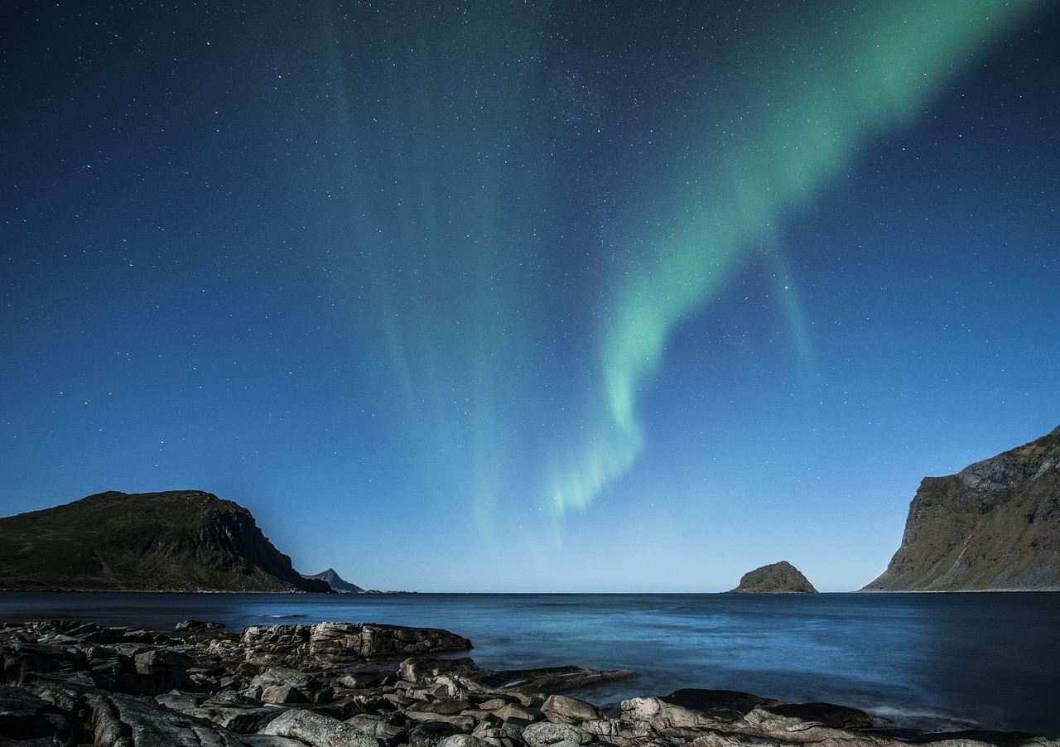
Unity creates a sense of belonging and increases well-being for all.
Unity is built from a shared vision, hope, an altruistic aim or a cause for the common good.
Pause for Thought
What does “unity” mean to you?
How can you create more unity in your life?
Pause for Thought
What does “unity” mean to you?
In what ways do you demonstrate unity in your life?
http://www.livingvalues.net
http://www.livingvalues.net

Slide 26


We hope that you enjoy making good use of these bookmarks and wish you a wonderful Values Day and many values-filled days ahead.
Best wishes
Association for Living Values Education International
www.livingvalues.net
Music: https://www.bensound.com

